Slide 1

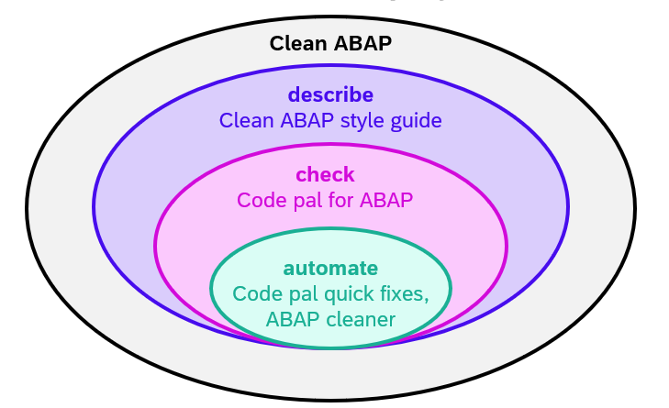
ABAP Tools for Clean ABAP
Björn Jüliger, SAP Jörg-Michael Grassau, SAP
June 6th, 2024 – ABAPCONF 2024 EUROPE

Slide 2
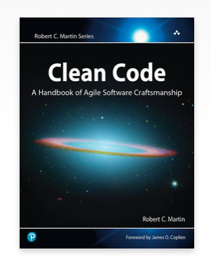
Why Clean ABAP?
Adaptation of Clean Code principles for ABAP
Readable, testable and maintainable code
Optimized for the reader:
We spend more time reading than writing code
We read own custom code + SAP code
ABAP has evolved over a long time with backward-compatibility in mind
Legacy code vs. new code

Slide 3
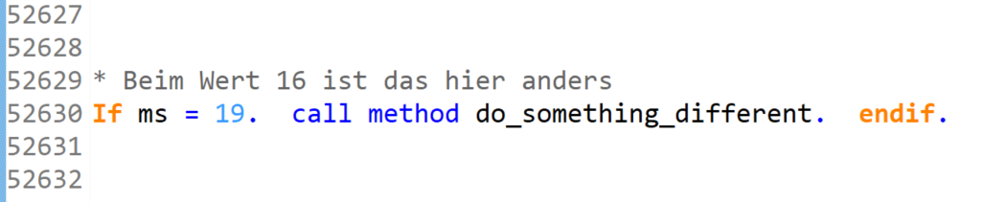
You need another motivation?
* Disclaimer: No productive code from SAP besides the class with 52623 lines of code ☺

Slide 4
Agenda

Slide 5
Clean ABAP Style guide – Useful Links
Style guide:
https://github.com/SAP/styleguides/blob/main/clean-abap/CleanABAP.md
Introduction:
https://blogs.sap.com/2021/03/17/why-clean-abap-a-foundation-for-improvements
You want to contribute to the Style guide?
https://github.com/SAP/styleguides/blob/main/CONTRIBUTING.md
https://github.com/SAP/styleguides/blob/main/GOVERNANCE.md

Slide 6
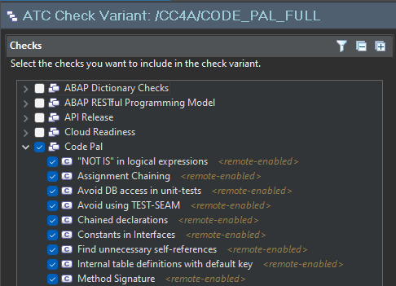
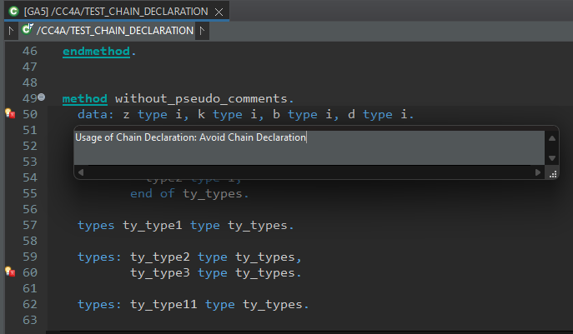
Code pal for Clean ABAP
Set of ABAP test cockpit (ATC) checks to control the usage of Clean ABAP
Provided as Open Source via Github (managed by ATC Team)
Integrated via ATC in ABAP development tools (ADT)

Slide 7
Code pal for Clean ABAP
Code pal (Classic)
https://github.com/SAP/code-pal-for-abap
https://blogs.sap.com/2022/05/05/how-to-enable-clean-code-checks-for-abap
Available for on-premise: AS ABAP 7.40 SP08 (++), not remote-enabled
NEW: Code pal (Cloud Edition)
https://github.com/SAP/code-pal-for-abap-cloud/
https://blogs.sap.com/2023/09/11/clean-code-checks-for-abap-cloud-edition
Available for Cloud + on-premise: AS ABAP 7.58 (2023), remote-enabled
Including Quick fixes to automate code adaptation (ADT-only)

Slide 8
Demo: Code pal for ABAP

Slide 9
Agenda – ABAP cleaner
1
5
What is ABAP cleaner?
How can you configure ABAP cleaner?
2
6
Who is it for and why should you use it?
How will the project evolve?
3
7
Where can you get ABAP cleaner?
Q&A
4
How can you use ABAP cleaner?

Slide 10
What is ABAP cleaner?

Slide 11

What is ABAP cleaner?
“ ABAP cleaner is a configurable tool with the ambition to automate whatever can be automated with respect to ABAP code style. ”

Slide 12
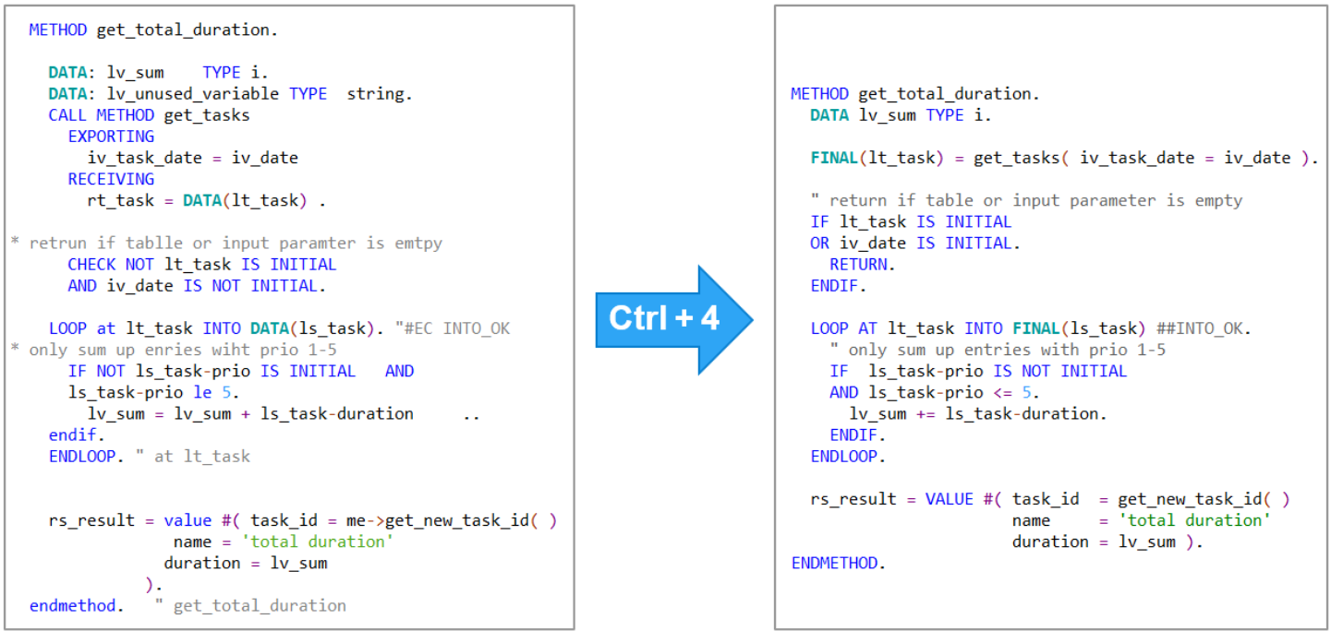
What is ABAP cleaner?
ABAP cleaner applies 75+ cleanup rules to ABAP code at a single keystroke
Detailed configuration of cleanup rules as needed by your team
Open-Source ADT plug-in: https://github.com/SAP/abap-cleaner

Slide 13
Context: SAP-initiated Open Source projects on Clean ABAP
Clean ABAP = how to write readable, maintainable, testable ABAP code
Clean ABAP
describe
Clean ABAP style guide
check
Code pal for ABAP
automate
Code pal quick fixes
ABAP cleaner

Slide 14
Who is ABAP cleaner for and why should you use it?

Slide 15
Who is ABAP cleaner for?
Simply every ABAP developer!
At a customer, at a partner, at SAP
In development or maintenance
In a team or on your own
Using ABAP Development Tools (ADT) (preferred) or SAP GUI (via clipboard)

Slide 16
Why should you use ABAP cleaner?
ABAP cleaner makes your life easier when …
Writing code
Reading code
Reviewing code
Upskilling colleagues
Integrating your (non-)perfectionist colleague 🧐🙂
… thus leaving you more time for …
Solving the more complex issues and (Code pal) findings
Reviewing and discussing the algorithm etc.

Slide 17
Demo: Where can you get ABAP cleaner?

Slide 18
Demo: How can you use ABAP cleaner?

Slide 19
Demo: How can you configure ABAP cleaner?

Slide 20
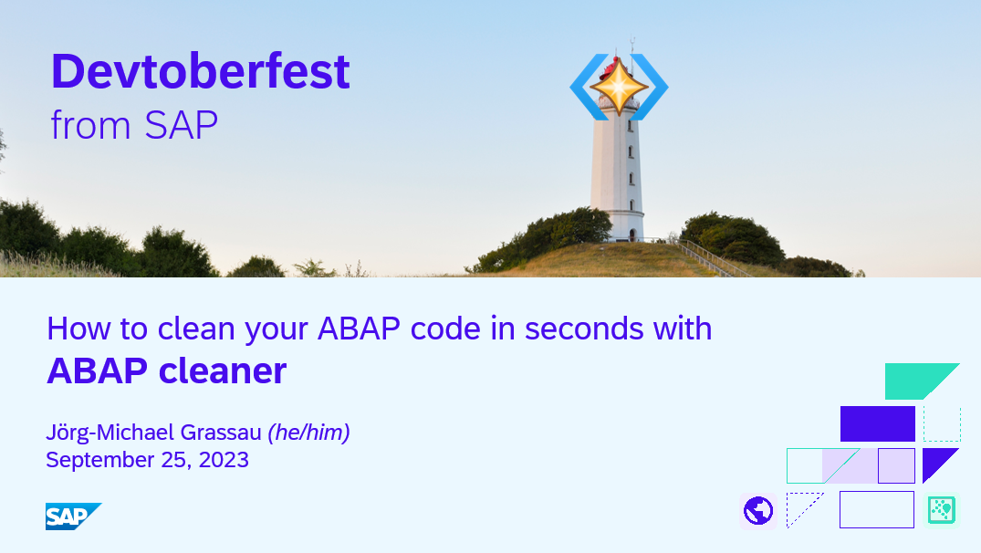
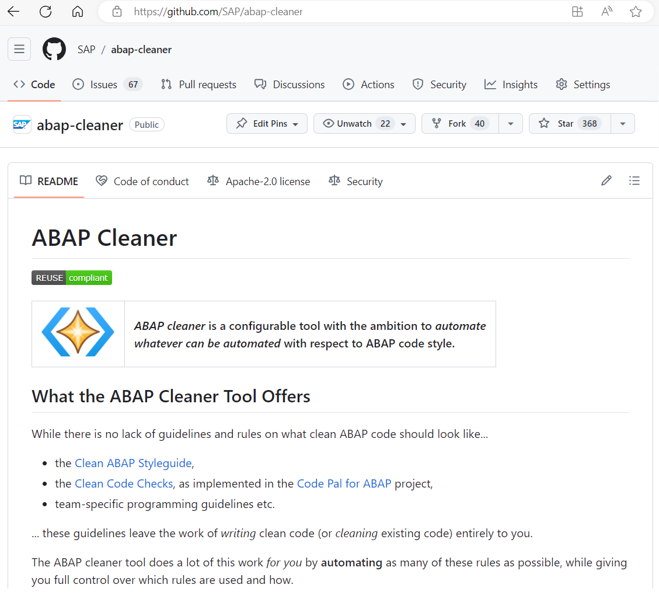
More on how to install, use and configure ABAP cleaner
For > 60 minutes demo on how to install, use and configure ABAP cleaner, watch the Devtoberfest session on YouTube:
And of course you can find everything on the ABAP cleaner repository at https://github.com/SAP/abap-cleaner

Slide 21
How will ABAP cleaner evolve?

Slide 22

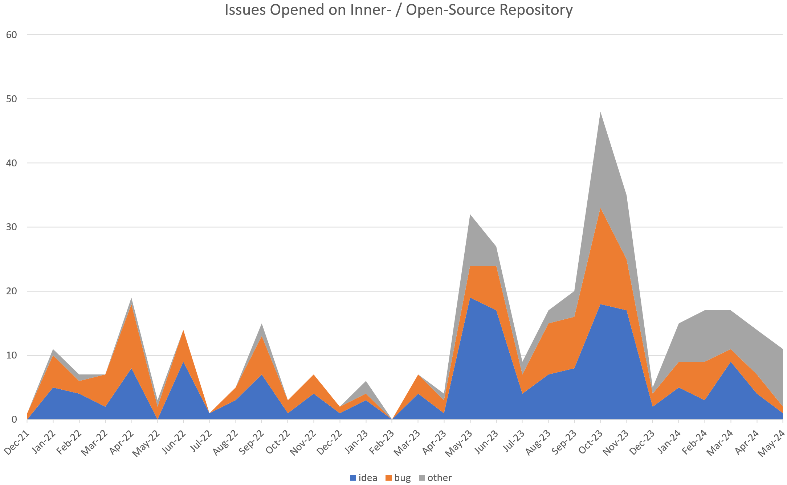
Community engagement
Devtoberfest session
112 issues on InnerSource repository (now closed)
268 issues on Open Source repository in first year
Open Source
Gray (24%) = no defect, duplicate, out of scope
Inner Source
Orange (32%) = bugs, dumps, unexpected cleanup results, poor alignment
Blue (44%) = ideas for new cleanup rules, new options, new UI features etc.

Slide 23
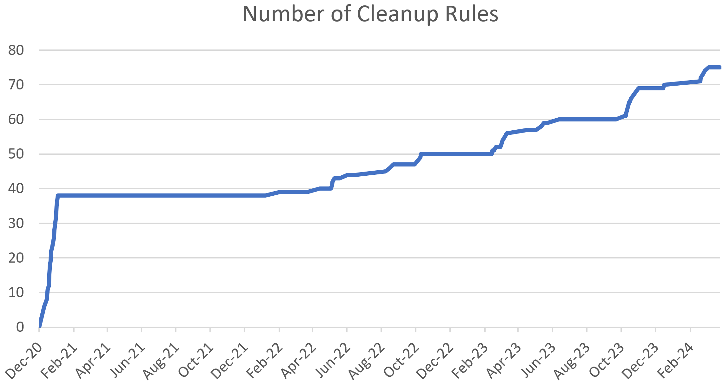
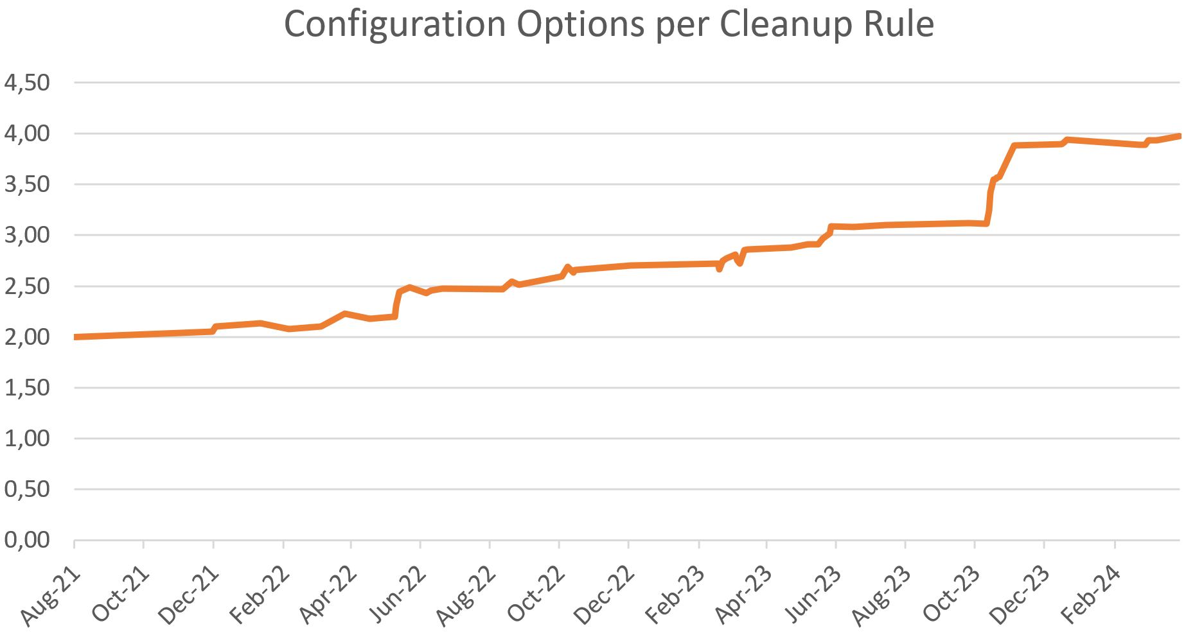
Evolution of ABAP cleaner
Open Source
Once the project was InnerSource / Open Source, lots of new ideas for cleanup rules and other features were posted by the community!
Inner Source
More users => more diverse code styles => more need for configuration
More users => more code styles * configuration variants => more bugs found => more fixes + tests => more stability

Slide 24
How will ABAP cleaner evolve?
For sure:
New cleanup rules and configuration options – already lots of great ideas + discussions on the repo
New UI features as needed
Bugfixes and adjustments to the evolving ABAP language as needed
Keep test coverage up at approx. 90% – crucial to avoid regression
Possibly:
Support for newer ABAP language constructs such as EML (Entity Manipulation Language)
Support for SQL Script / AMDP (ABAP-Managed Database Procedures)
Out of scope:
Using backend calls to get signatures, DDIC information etc. => keep ABAP cleaner running local and fast
Support for other languages (e. g. CDS View Definitions)
SAP GUI integration => time to switch to ADT ;-)
Embedding AI – ABAP cleaner automation is deterministic => no hallucinations, review must NOT be necessary

Slide 25



How to contribute
If you like ABAP cleaner: spread the word
Report bugs
Open an issue on the GitHub repository
With a minimal example, show actual vs. expected result
Tell us about your ideas
What else could be automated? What config is needed?
What UI features are missing?
Contribute to development
With just one click: give it a star
=> Only your feedback shows us if it’s worth the effort

Slide 26
Resources
ABAP cleaner:
Open Source repository: https://github.com/SAP/abap-cleaner with Installation Instructions, Documentation, Release Notes, list of Available Cleanup Rules, Issues etc.
Updatesite for Eclipse plug-in: https://sap.github.io/abap-cleaner/updatesite
Demo: Devtoberfest session on YouTube showing in depth how to install, use and configure ABAP cleaner
Webinar on the Open Source journey of ABAP cleaner, hosted by Open Source Program Office (slides)
Blog post: How to Clean Your ABAP Code with One Keystroke Using ABAP Cleaner (sap-press.com)
Related Open Source Projects on Clean ABAP, see blog ABAP Tools for Clean ABAP:
“Describe”: Clean ABAP style guide
“Check”: Code pal for Cloud (incl. Quick Fixes) + Code pal, abaplint, abapOpenChecks
“Automate”: Code pal for Cloud Quick Fixes, abaplint, ABAP Quick Fix

Slide 27
Thank you.
Björn Jüliger
bjoern.jueliger@sap.com
Joerg-Michael Grassau
abap-cleaner@sap.com

